Slide 1


Slide 2

School of Computing Science and Engineering
Course Code: BCS01T1001 Course Name: Data Analytics (Excel and Tableau)
Unit 3
Exploring Analysis Tool pack
Faculty Name: Dr.L.Godlin Atlas Program Name: B.Tech

Slide 3
Objective
Histogram
Descriptive Statistics
Moving Average
Exponential
Correlation
Regression

Slide 4
Introduction
Histogram
A histogram is the most commonly used graph to show frequency distributions.
It looks very much like a bar chart, but there are important differences between them.
This helpful data collection and analysis tool is considered one of the seven basic quality tools.

Slide 5
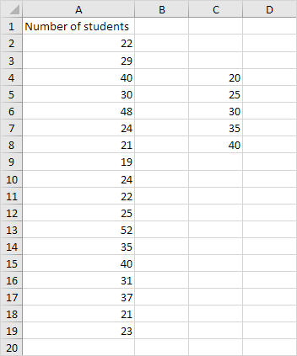
Histogram
1. First, enter the bin numbers (upper levels) in the range C4:C8.

Slide 6
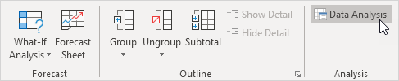
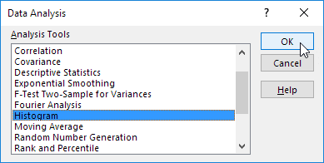
Histogram
2. On the Data tab, in the Analysis group, click Data Analysis.
3. Select Histogram and click OK.

Slide 7
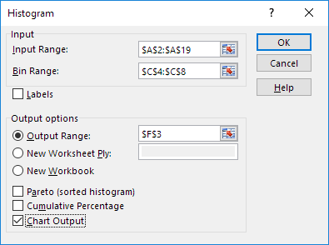
Histogram
4. Select the range A2:A19.
5. Click in the Bin Range box and select the range C4:C8.
6. Click the Output Range option button, click in the Output Range box and select cell F3.
7. Check Chart Output.
8. Click OK.

Slide 8
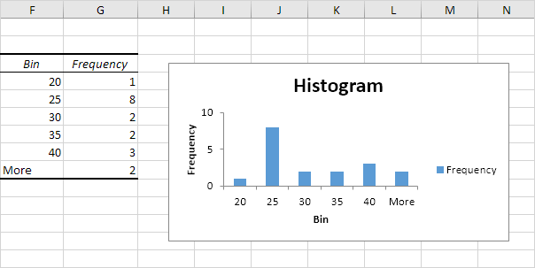
Histogram
9. Click the legend on the right side and press Delete.
10. Properly label your bins.
11. To remove the space between the bars, right click a bar, click Format Data Series and change the Gap Width to 0%.
12. To add borders, right click a bar, click Format Data Series, click the Fill & Line icon, click Border and select a color.

Slide 9
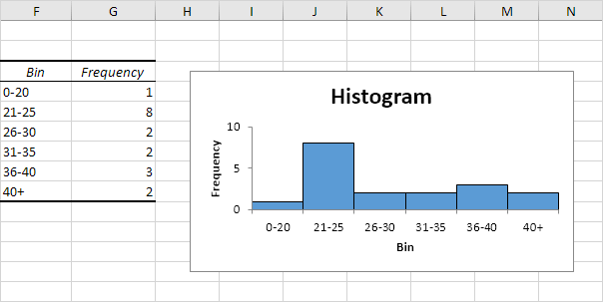
Histogram
Result:

Slide 10
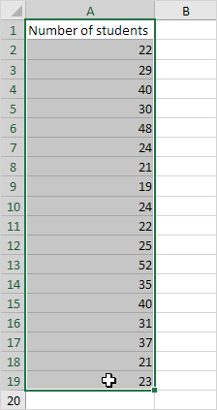
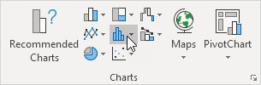
Histogram
If you have Excel 2016 or later, simply use the Histogram chart type.
13. Select the range A1:A19.
14. On the Insert tab, in the Charts group, click the Histogram symbol.

Slide 11
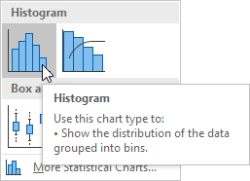
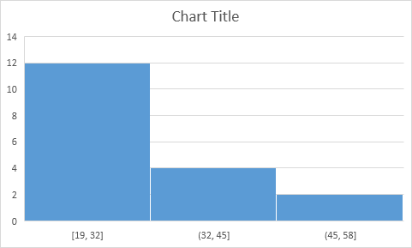
Histogram
15. Click Histogram.
Result. A histogram with 3 bins.

Slide 12
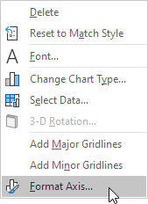
Histogram
Note: Excel uses Scott's normal reference rule for calculating the number of bins and the bin width.
16. Right click the horizontal axis, and then click Format Axis.

Slide 13
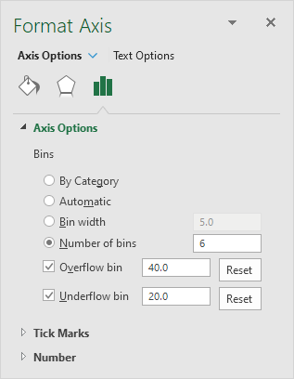
Histogram
The Format Axis pane appears.
17. Define the histogram bins. We'll use the same bin numbers as before (see first picture on this page). Bin width: 5. Number of bins: 6. Overflow bin: 40. Underflow bin: 20.

Slide 14
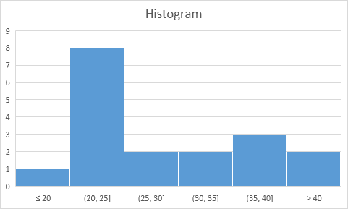
Histogram
Result:
Recall, we created the following histogram using the Analysis ToolPak (steps 1-12).
Conclusion: the bin labels look different, but the histograms are the same. ≤20 is the same as 0-20, (20, 25] is the same as 21-25, etc.

Slide 15
References
Books:
1. Microsoft Excel 2013 Step by Step by Curtis D. Frye; Microsoft Press 2013.
2. Learning Tableau by Joshua N. Milligan,ISBN 139781784391164, PACKT Books - Packt Publishing
Reference Books:
Excel: Quick Start Guide from Beginner to Expert, by William Fischer
Web:
1. https://www.excel-easy.com/examples/correlation.html

Slide 16
For Queries Contact
Dr.L.Godlin Atlas
Email Id: godlin.atlas@galgotiasuniversity.edu.in
Whatsapp: 9080806220

Slide 17


